Slide 1

EVOKE ARCHITECTURE
RENDERS FOR
Mr. PRABU– SHOLINGANALLUR

Slide 2
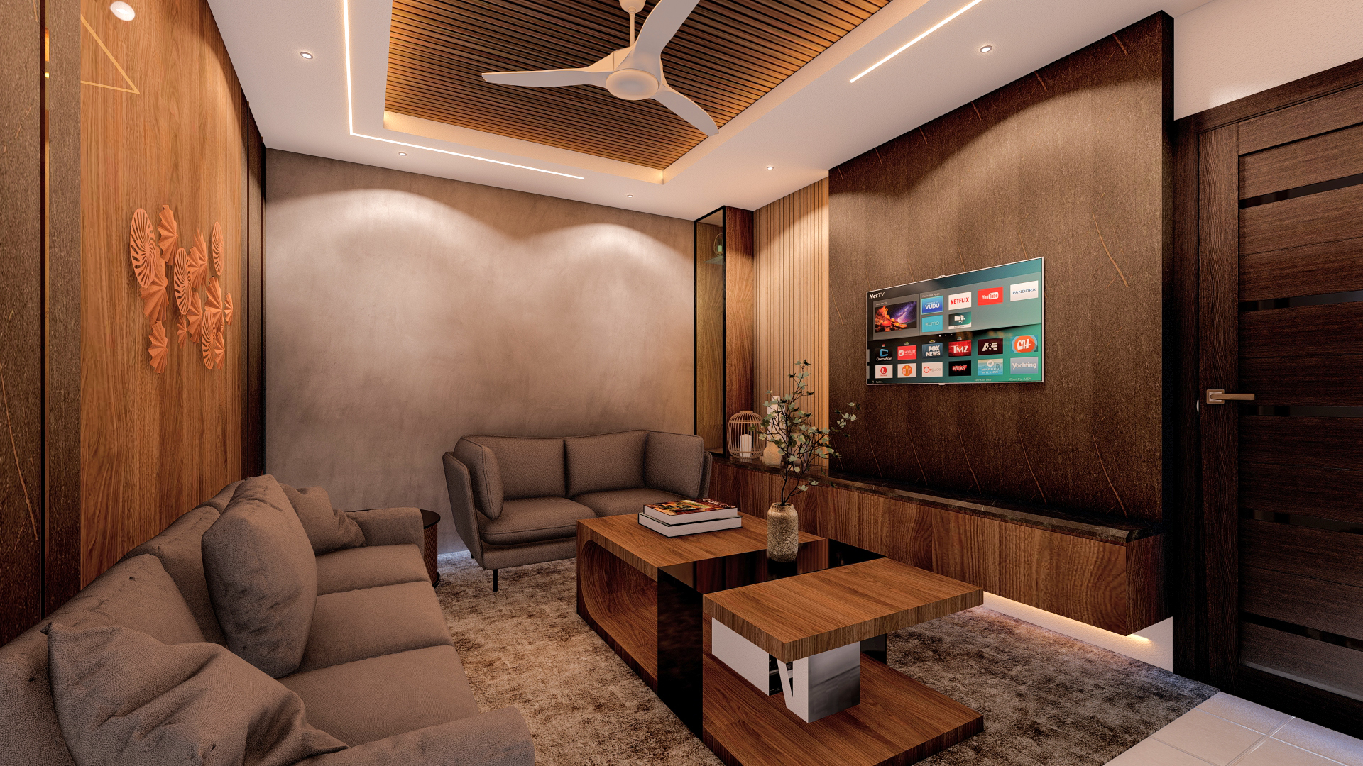
LIVING ROOM

Slide 3
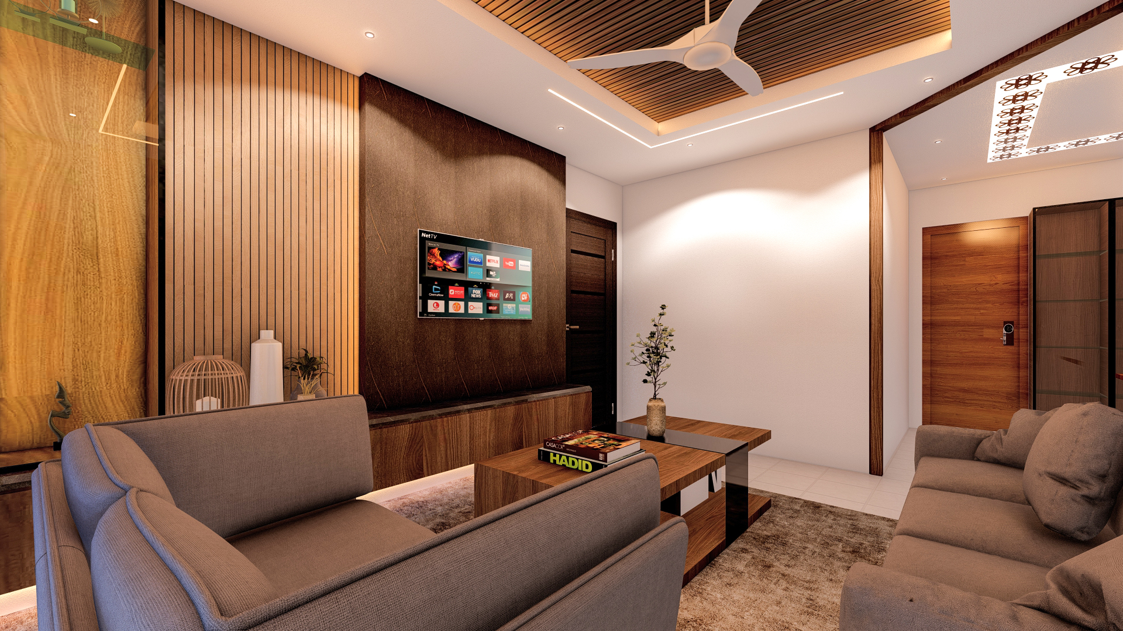
LIVING ROOM

Slide 4
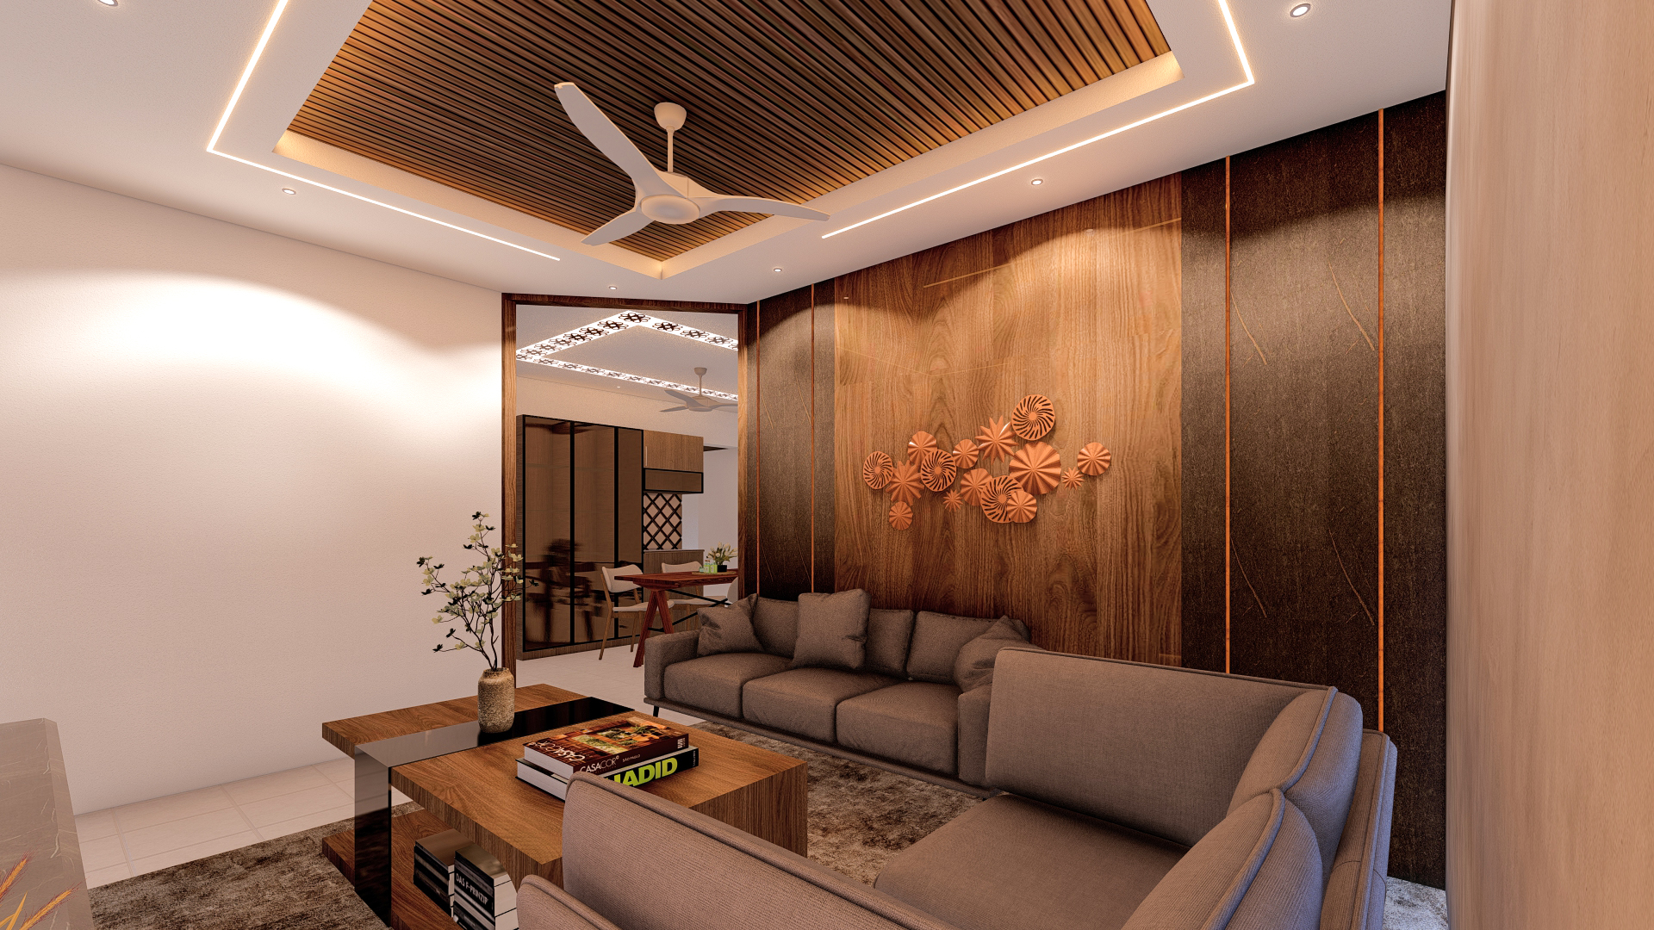
LIVING ROOM

Slide 5
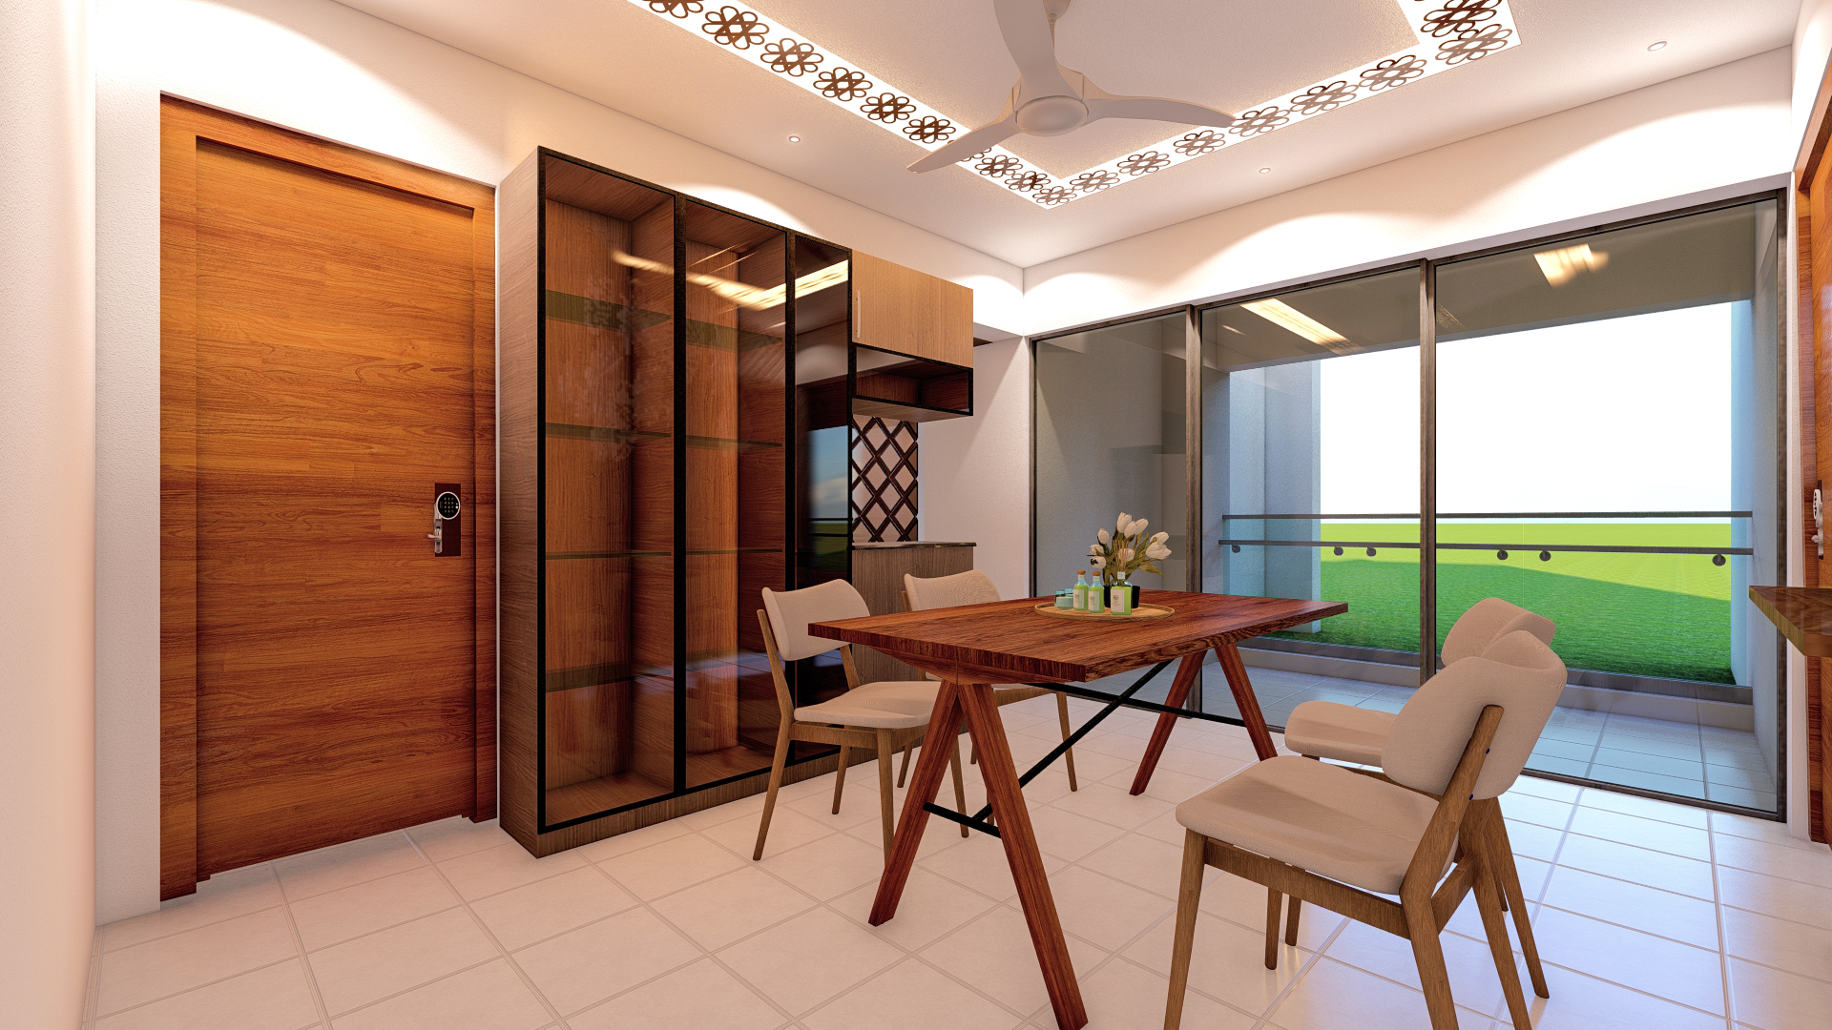
DINING

Slide 6
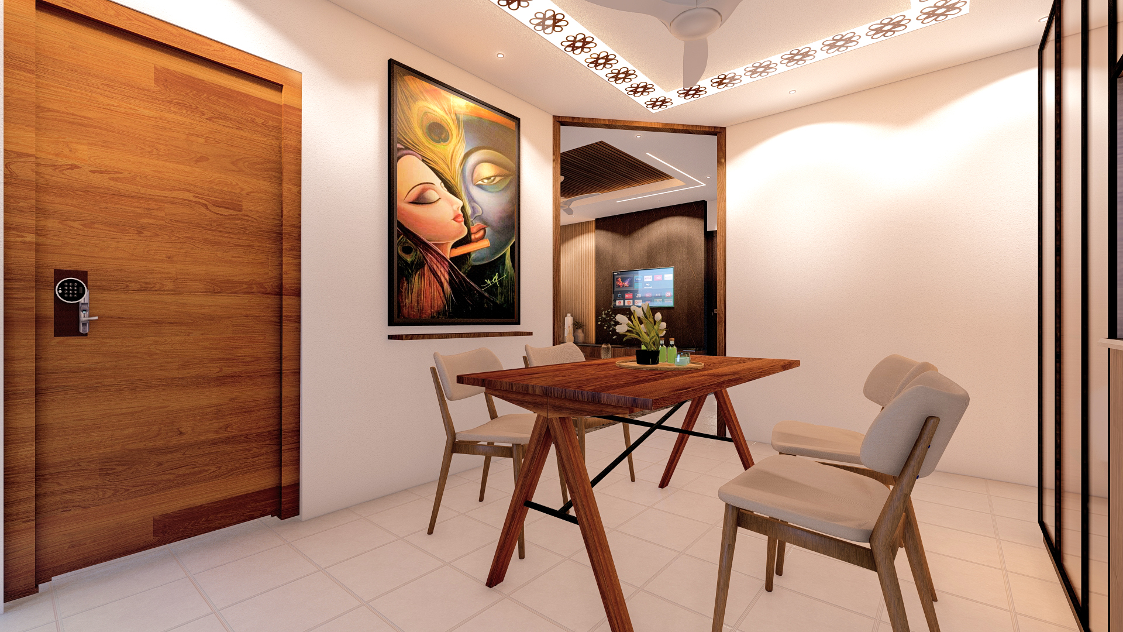
DINING

Slide 7
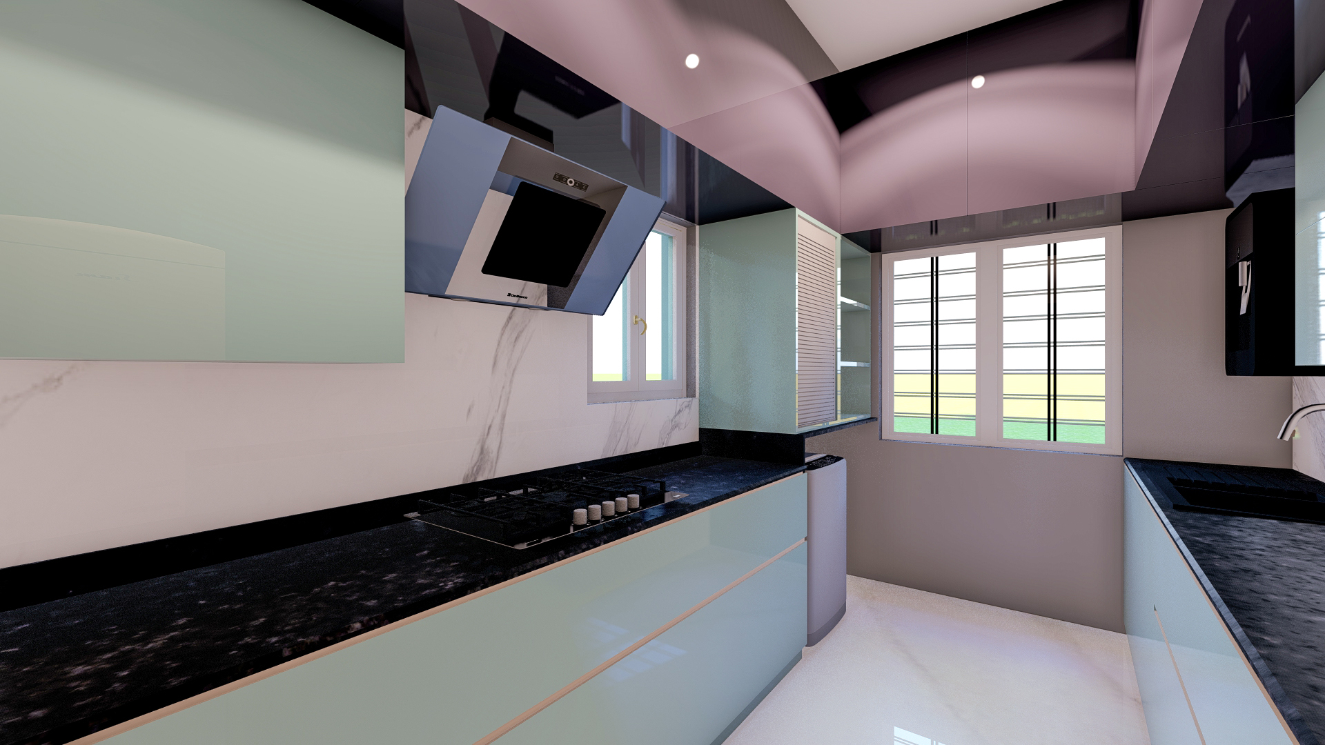
KITCHEN

Slide 8
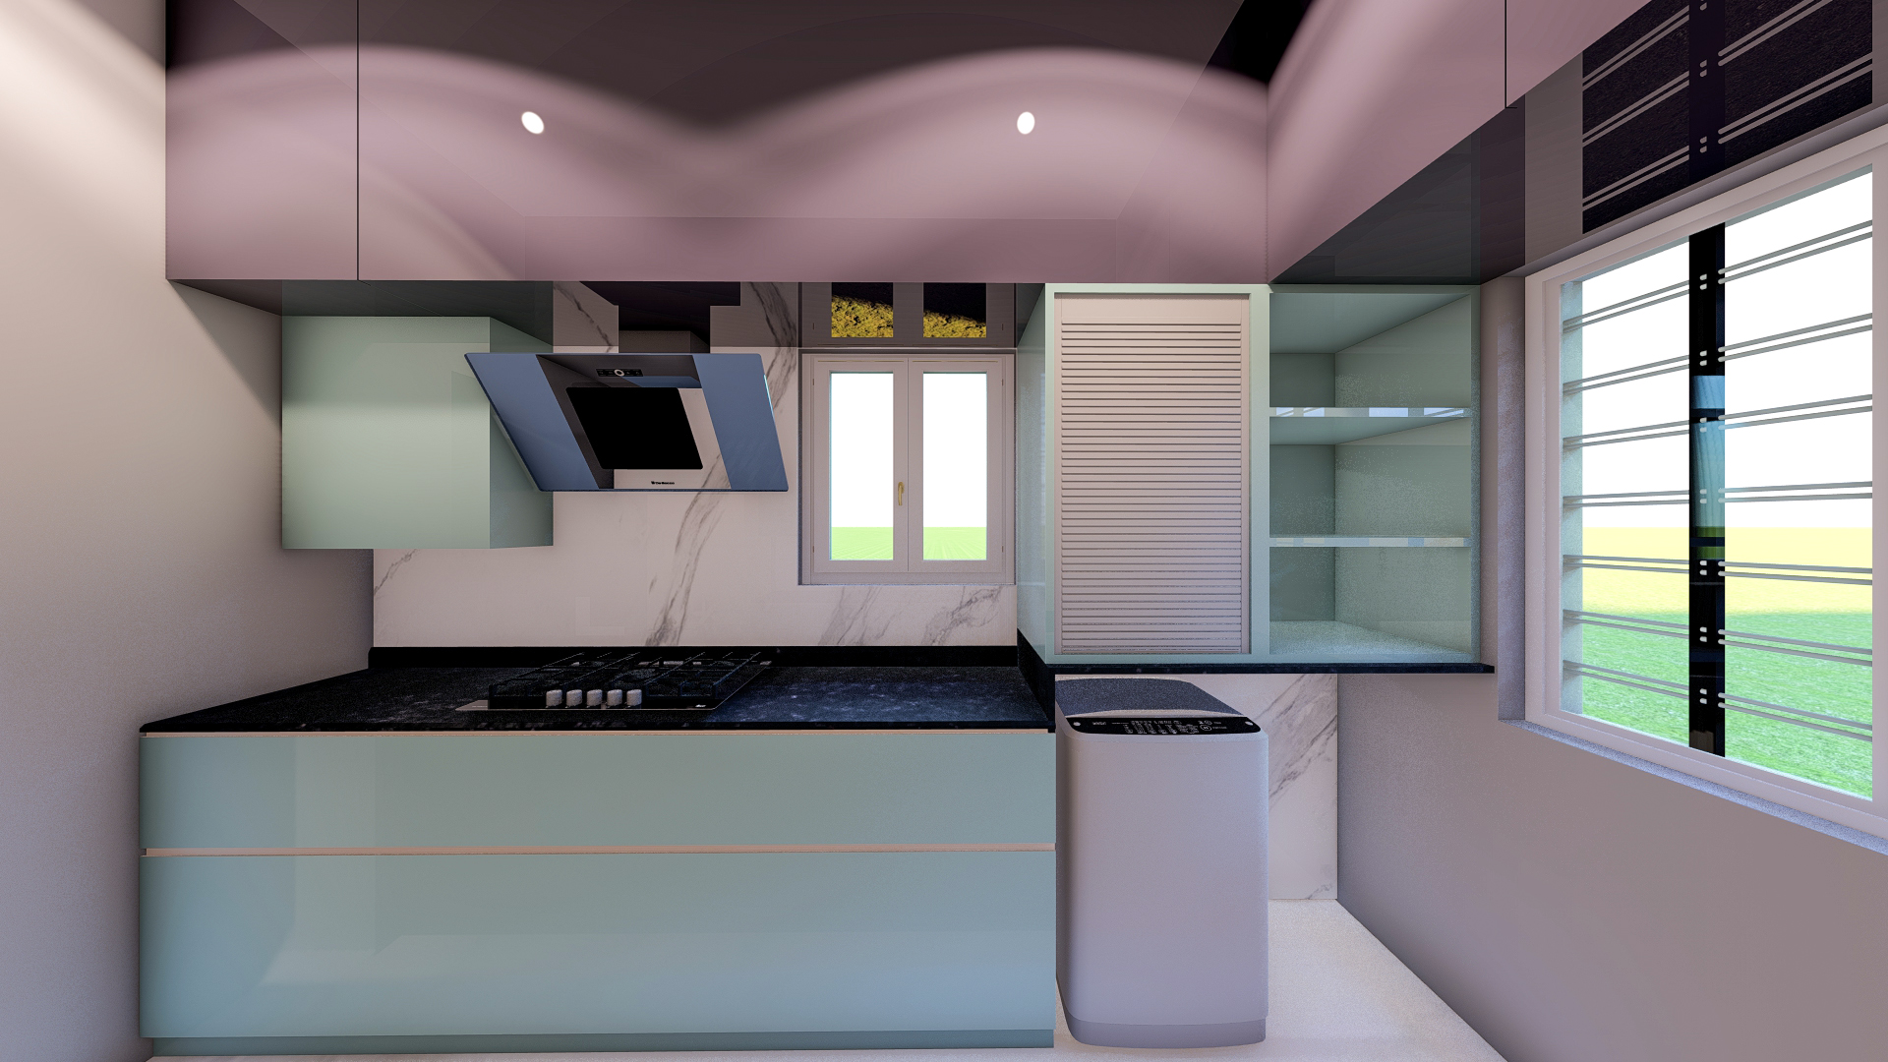
KITCHEN

Slide 9
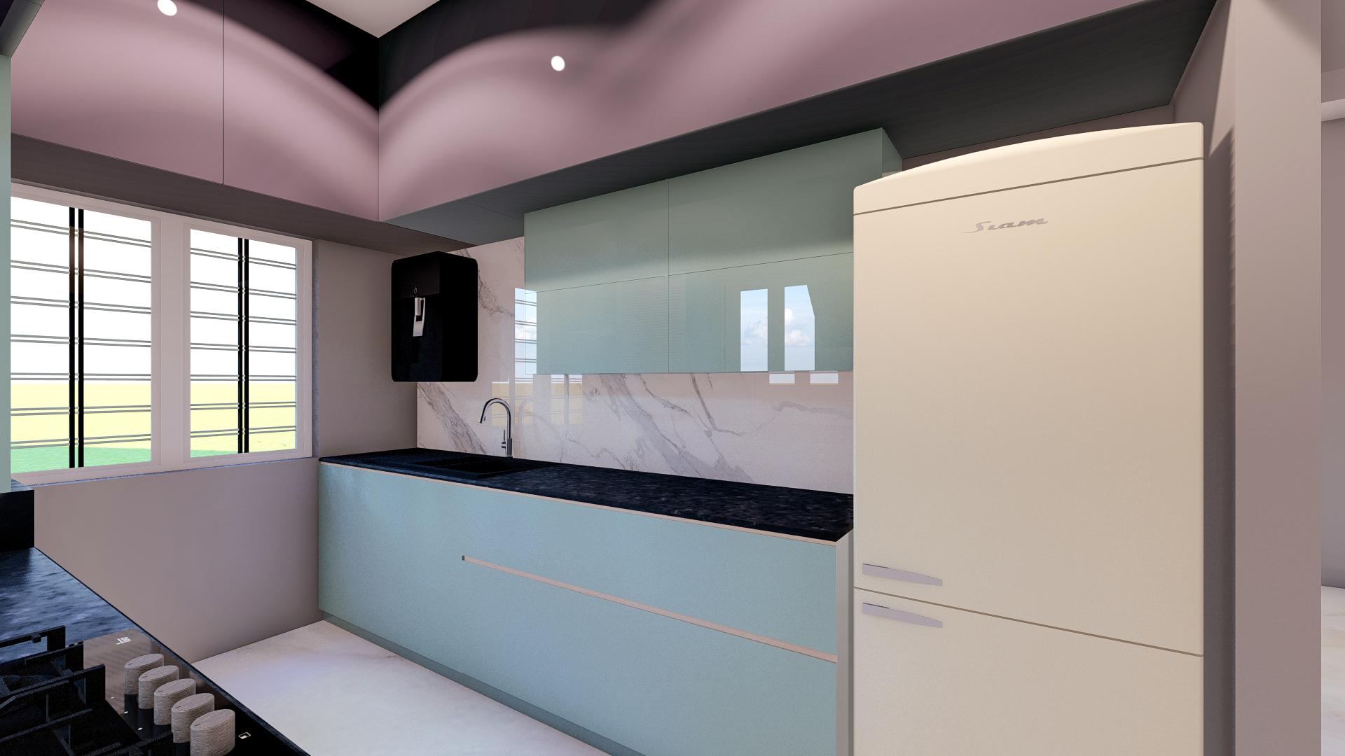
KITCHEN

Slide 10
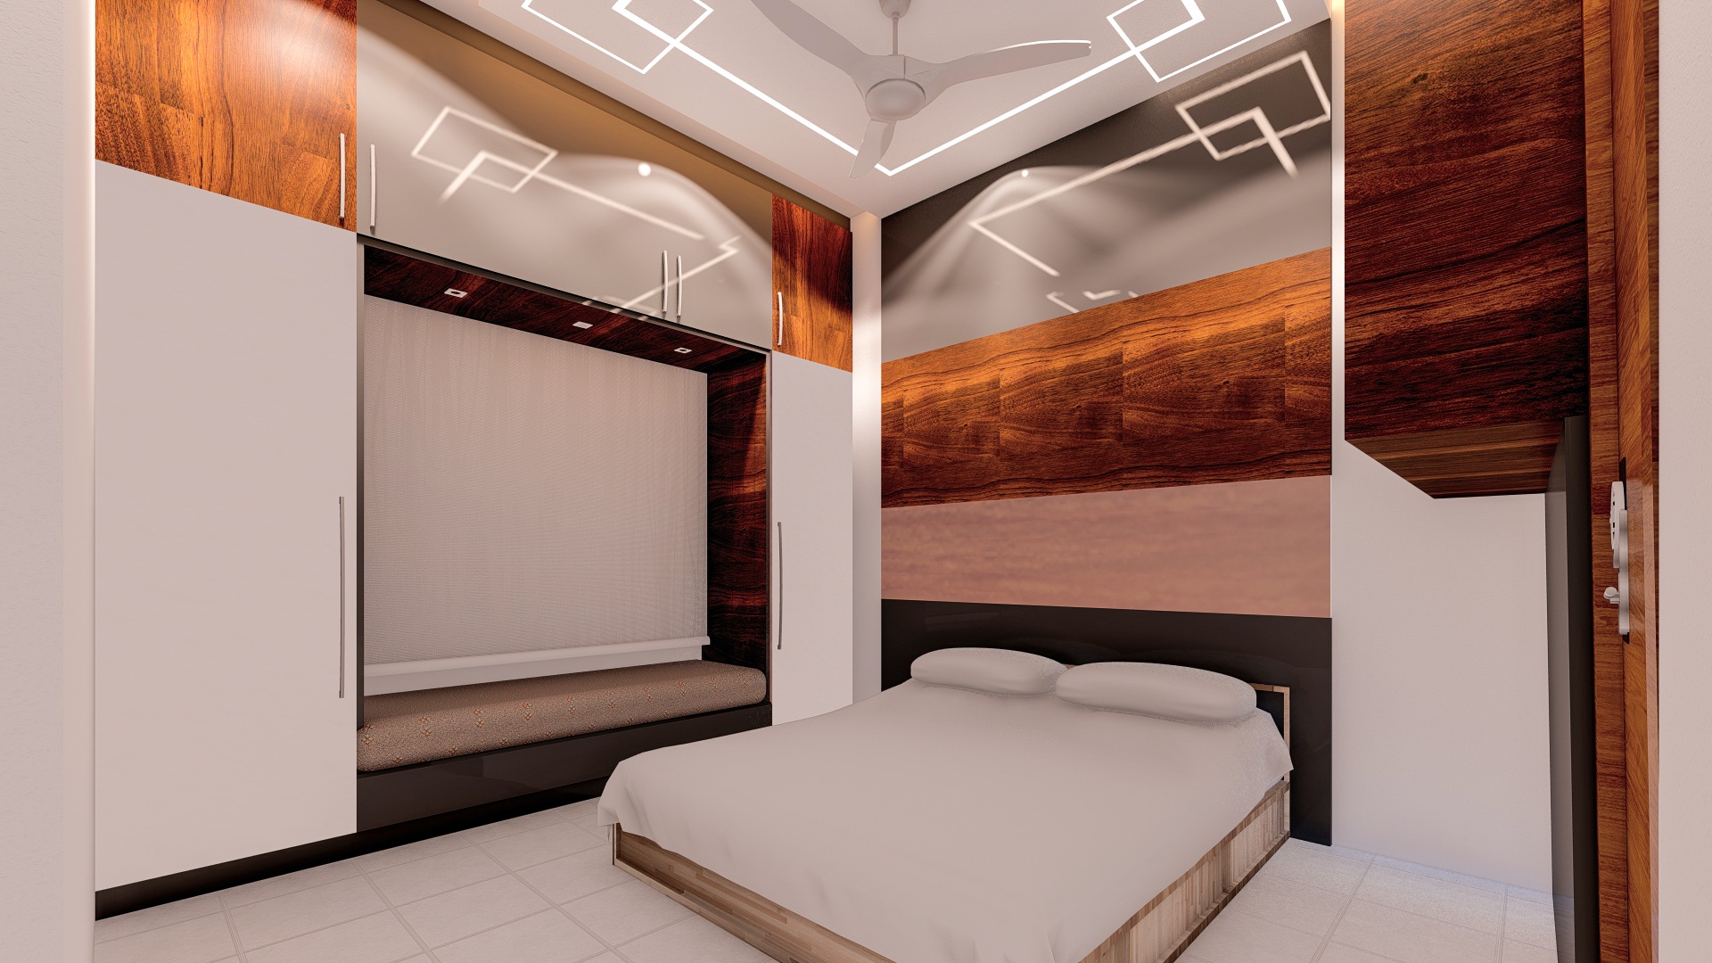
MASTER BEDROOM

Slide 11
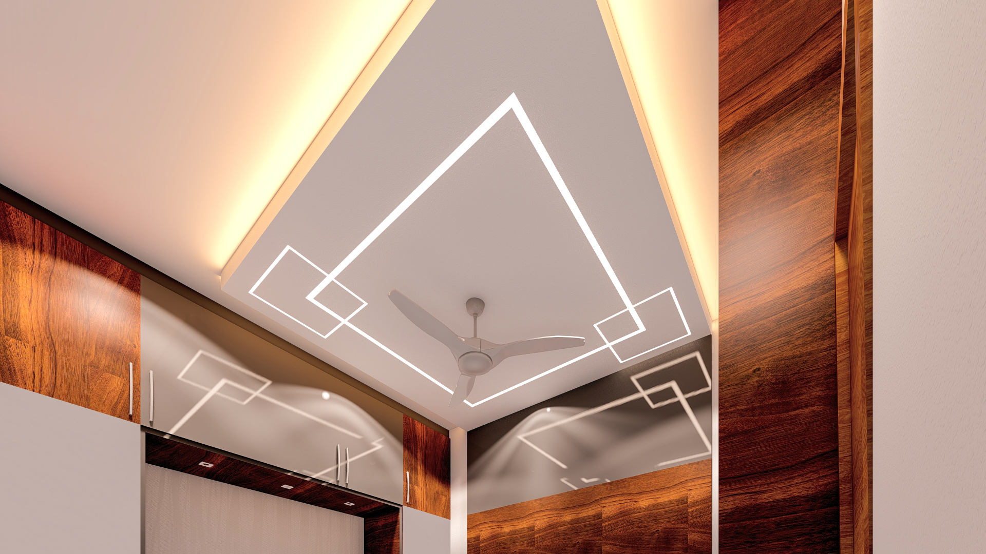
MASTER BEDROOM

Slide 12
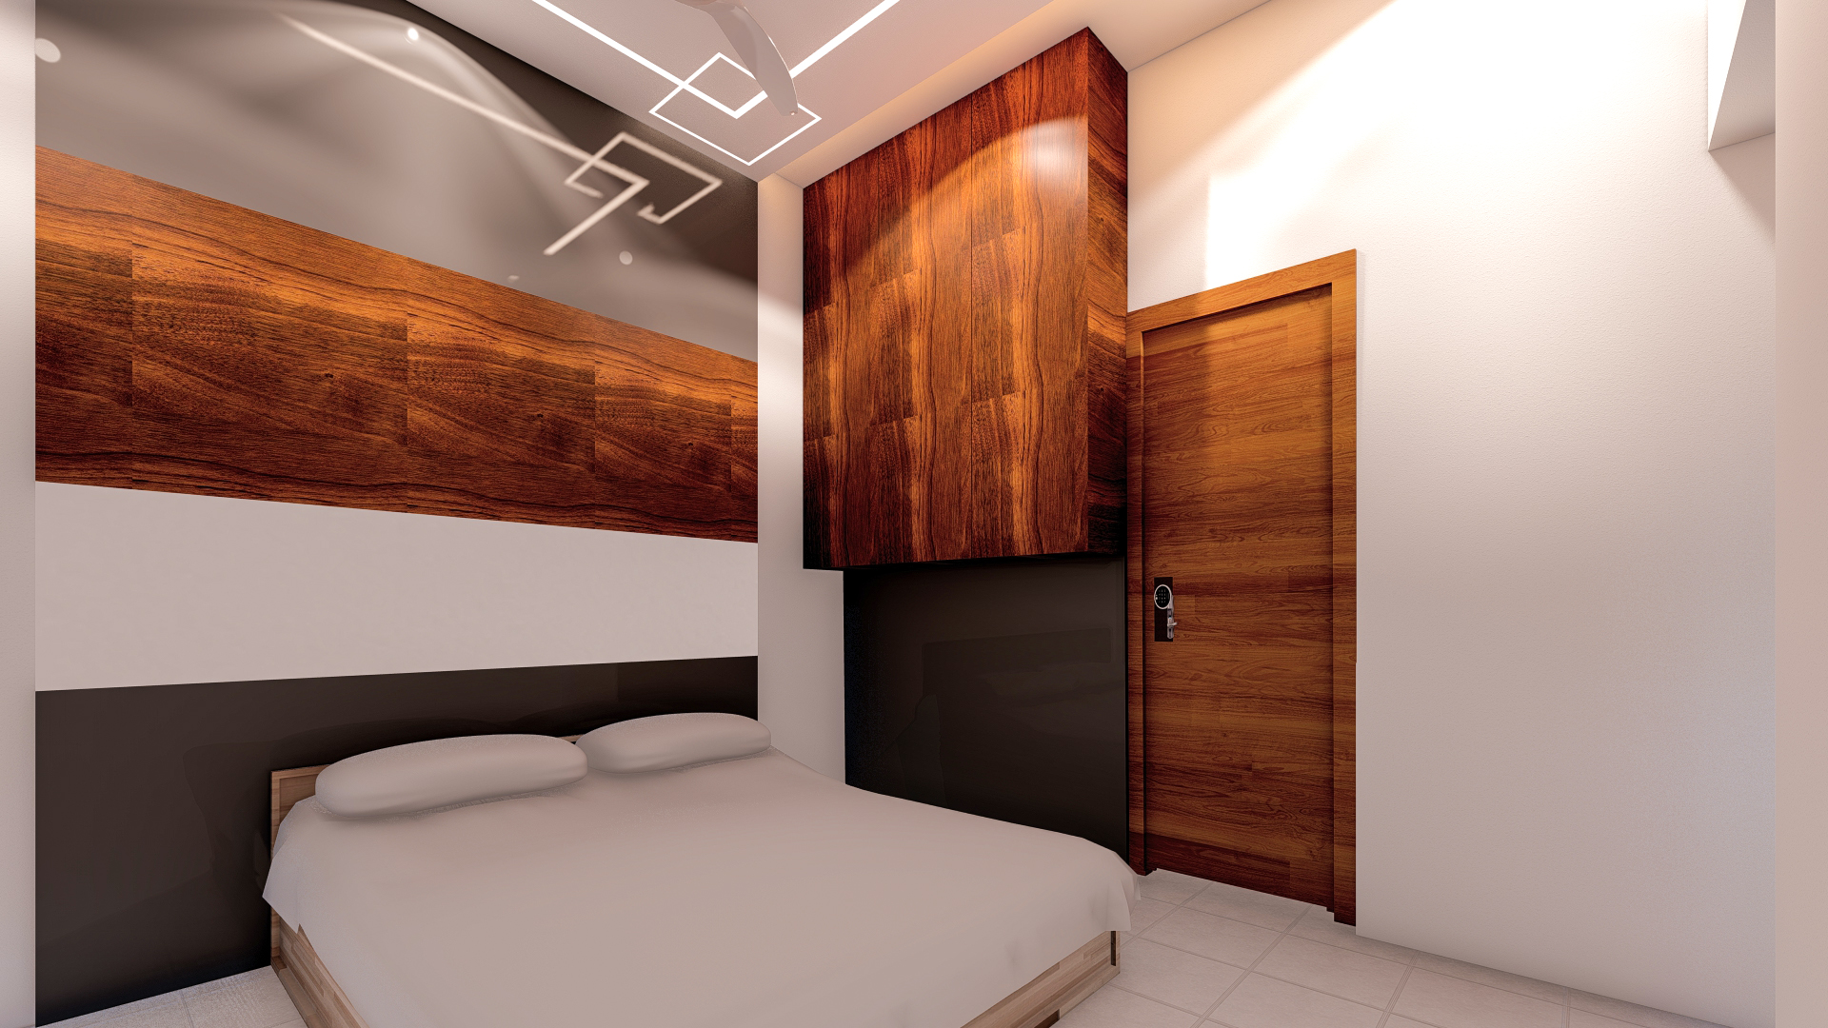
MASTER BEDROOM

Slide 13
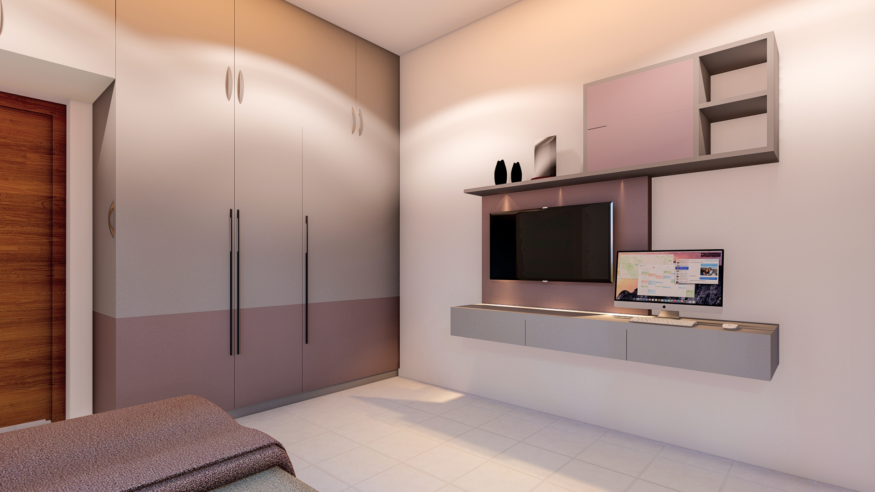
BEDROOM-2

Slide 14
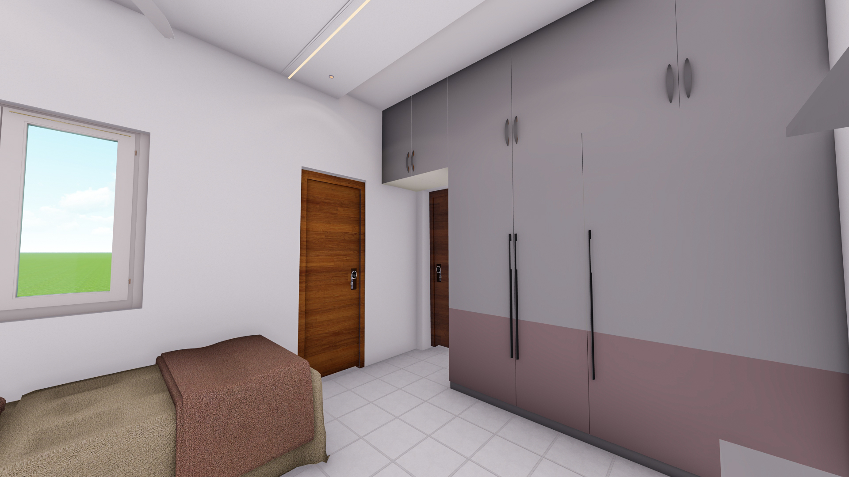
BEDROOM-2

